Slide 1

Connect 4 Connect This, Bitch
Akash Desai Computer Engineering Computer Science | Franky Romero Electrical Engineering

Slide 2

Background
Can be used to liven up family road trips!
Game requires memory of previous moves
Background | 1

Slide 3
User Interface
Buttons used to move piece
Current player and winning player displayed
User Interface | 2

Slide 4
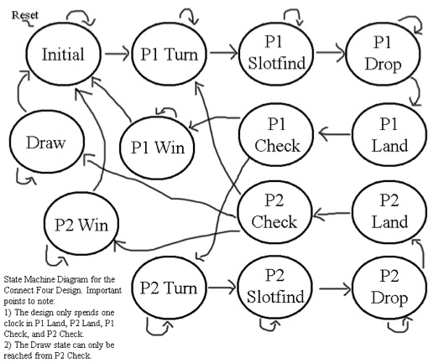
State Machine
State Machine | 3

Slide 5
Block Diagram
Top
HVSync Generator
Debouncer
VGA
RAM
State Machine
State Machine ⬅➔ RAM
write_address, read_address
write_data, read_data
RAM ⬅➔ VGA
Display color of slot based on slot value
HVSync ⬅➔ VGA
CounterX, CounterY
Debouncer
Button presses
Block Diagram | 4

Slide 6
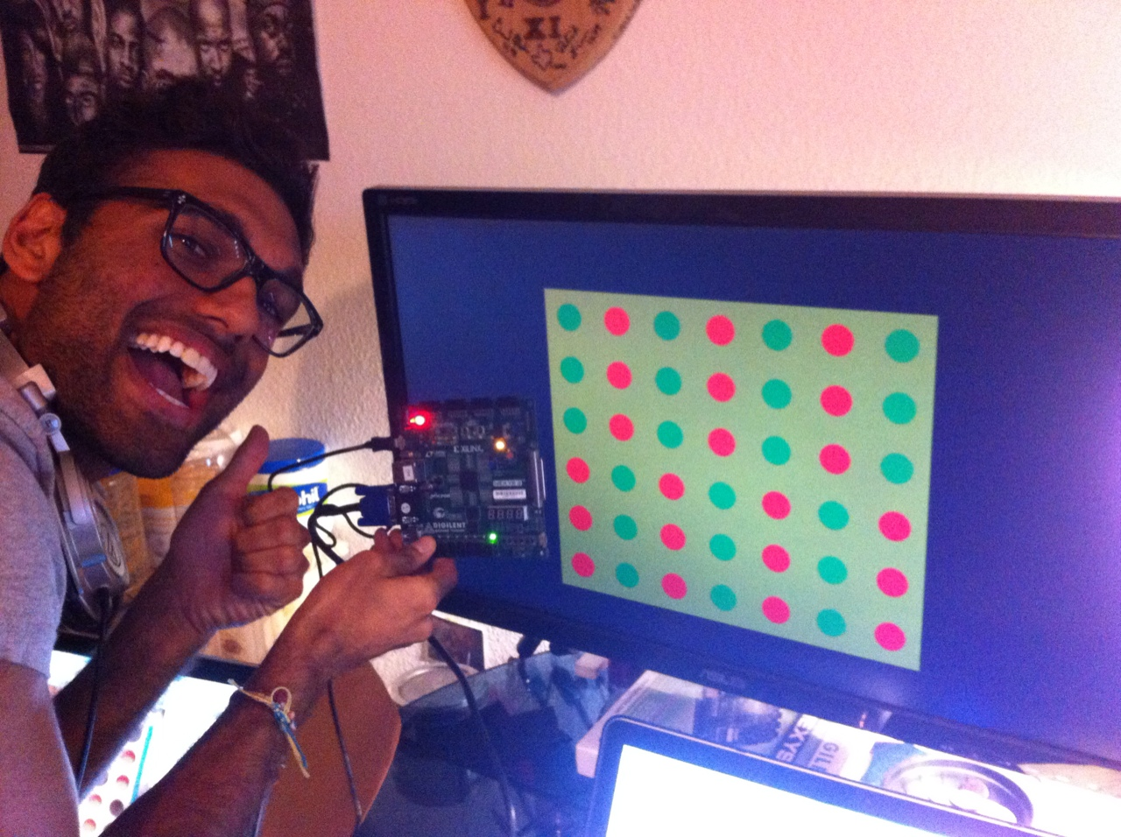
Test Methodologies
Tie game and winning combination
Drop-down animation
RAM read and write
Debouncer timing
Pixel counter and assignment timing
User Interface | 5

Slide 7
Conclusion
Circle drawing algorithm®
Animation timing
RAM implementation
VGA timing: wire vs. reg
Conclusion | 6

Slide 8
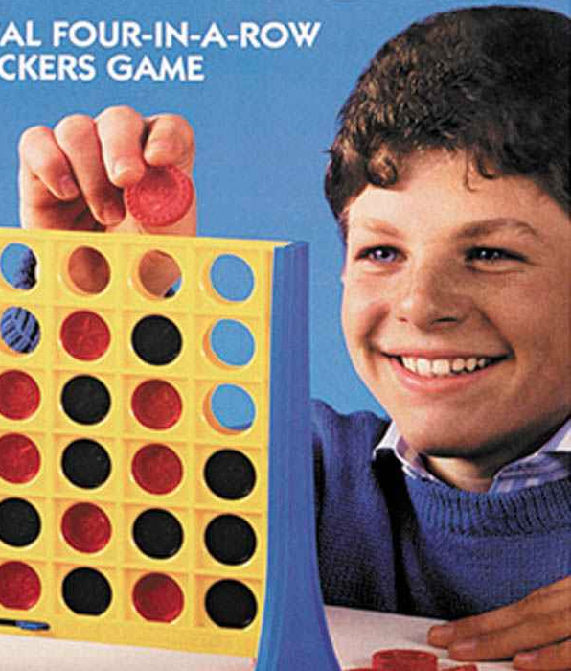
Any Questions?
This Kid | 7

